Slide 1
Probability & Statistics
Rijah Khan
Cyber Security

Slide 2
Chapter 4
Measures of Dispersion

Slide 3
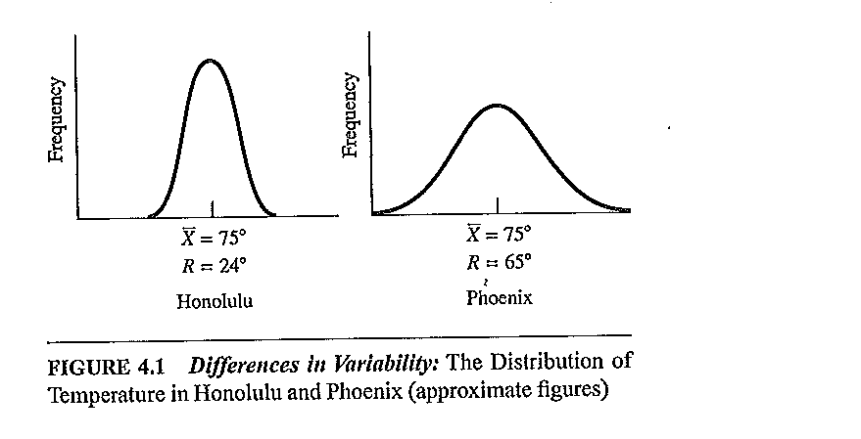
Measures of Dispersion
Dispersion characterizes how stretched or squeezed of the data.
A measure of statistical dispersion is a nonnegative real number that is zero if all the data are the same and increases as the data become more diverse.
Dispersion is contrasted with location or central tendency, and together they are the most used properties of distributions.

Slide 4
There are four types of dispersion measures:
Range
Mean Absolute Deviation
Standard Deviation
Variance

Slide 5
Range
The simplest measurement of variation is the range which measure variation in interval-ratio variables.
Range = max − min
Example 1: Find the range of the following data: 10, 7, 6, 2, 5, 4, 8, 1
Range = 10 − 1 = 9
Example 2: If the oldest person included in a study was 89 and the youngest was
18, then the range would be 71 years.

Slide 6
Range for Grouped Data
Range= Upper class boundary of the highest class -
Lower class boundary of the lowest class
Range= class mark of the highest class – class mark of the lowest class

Slide 7
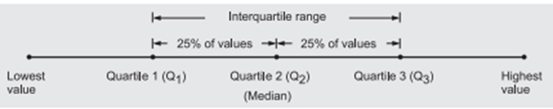

Semi-interquartile range or the quartile deviation
The interquartile range is a measure of dispersion or spread of values in the data set between the third quartile, Q3 and the first quartile, Q1.

Slide 8
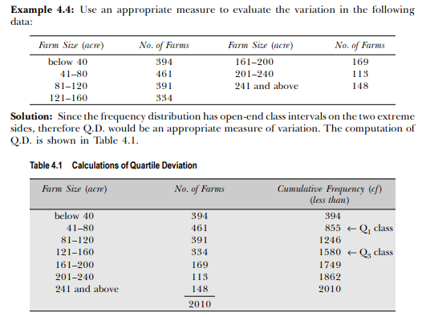
Example

Slide 9
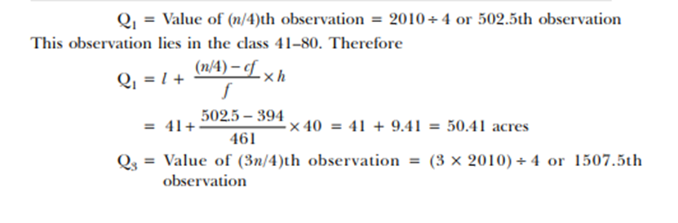
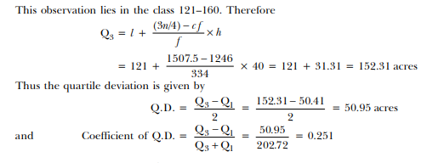

Slide 10

Mean Absolute Deviation
The absolute difference between a value xi of an observation from A.M. is always a positive number, whether it is less than or more than the A.M., therefore take the absolute value of each such deviation from the A.M. (or median). Taking the average of these deviations from the A.M.

Slide 11
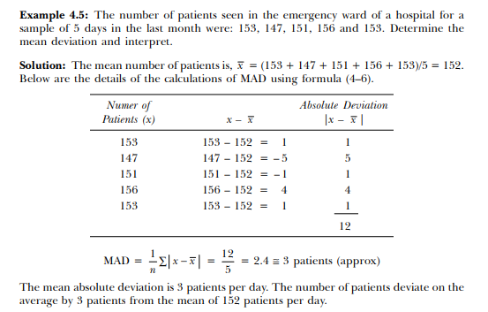
Mean Absolute Deviation for Ungrouped Data

Slide 12




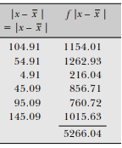

Mean Absolute Deviation for Grouped Data
175

Slide 13
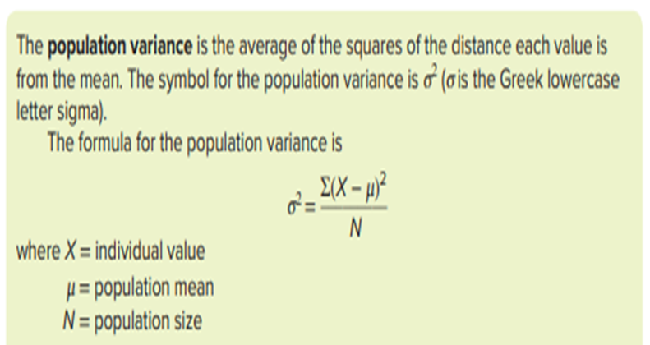
Population Variance(Ungrouped)

Slide 14

Population Standard Deviation (Ungrouped)

Slide 15
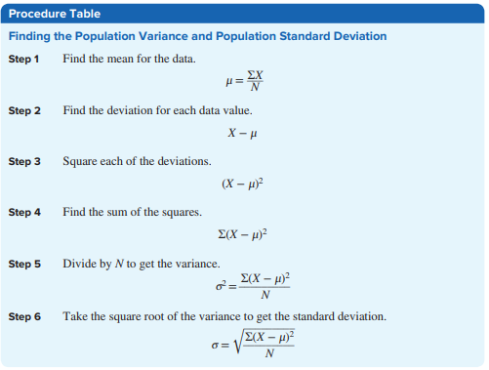

Slide 16
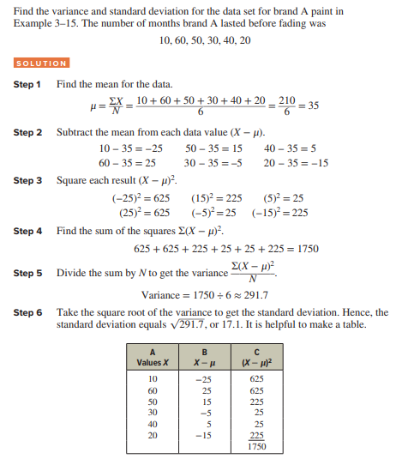
Example

Slide 17
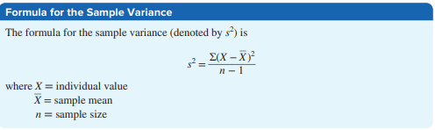
Sample Variance(Ungrouped)

Slide 18
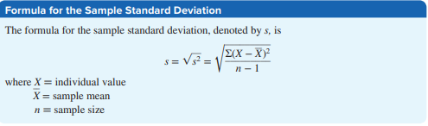
Sample Standard Deviation(Ungrouped)

Slide 19
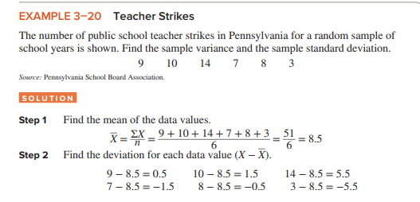
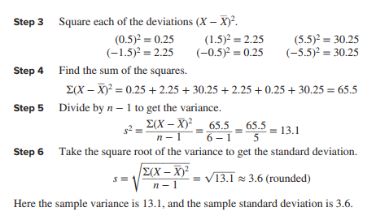
Example

Slide 20
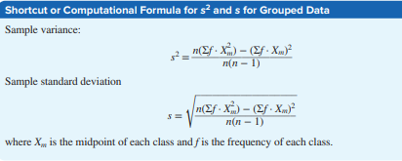
Variance and Standard Deviation for Grouped Data

Slide 21
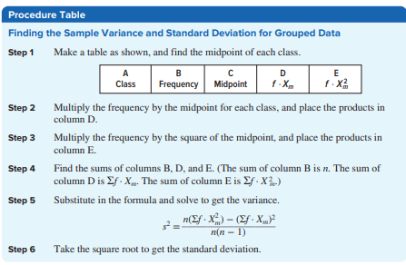

Slide 22
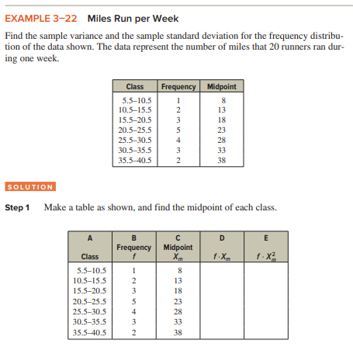
Example

Slide 23
